Slide 1

FreeSpirit – A Celebration Of Sharing Happiness

Slide 2








Introduction
FreeSpirit is a pioneering opportunity to bring people together like never imagined before, by expanding a proven & classic concept to join forces with modern technology platforms.
While this solution resolves chronic challenges faced by restaurant business, it also open up innovative prospects for consumers to connect not just with known acquaintances, but also to make new friends with customers having common interests & thinking.
It empowers restaurant business owners to offer their services to a completely new range of customers through mobile & web application, in a cost effective & accelerated manner.

Slide 3
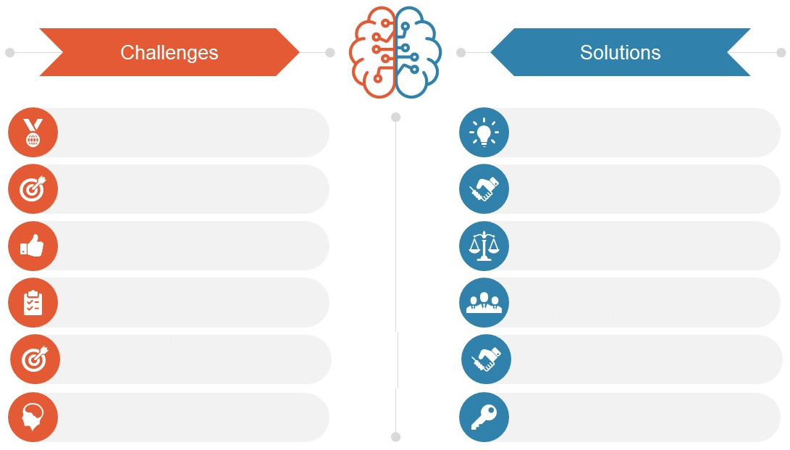
Industry Challenges & Solutions
Lack of options to share or gift a drink to friends or family
Unique & unmatched opportunity
to share/offer drink to anyone, anywhere
No socializing platforms in restaurant premises
Innovative technology driven platform for B2C & C2C interaction
Low margins of operation when utilizing traditional delivery models
Higher benefits & financial control with reduced expenses
No avenues for cost effective event arrangement or broadcast
Impactful means of event
organization & rapid marketing
Obligation of menu costing without future benefits
Use based costing, with exciting offers & guaranteed cashback
No tangible advantages of higher spend & lockdown sensitivities
More value for money & standardization of health & wellness

Slide 4
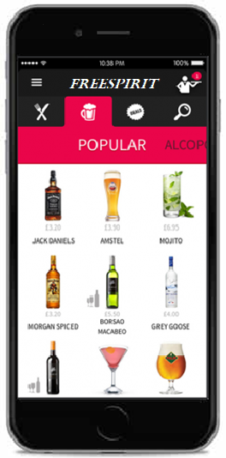








Product & Features
Gift a drink
Gift or share a drink of choice to your beloved ones e.g. Corporates, Family & Friends & colleagues
Broadcast & Live Streaming
Watch live shows & virtually share special moments with the dear ones & staff training demonstrations
Offer a drink
Offer service will be availed at merchant establishment with other groups or individuals
Eat Now, Pay Later
Service for the our bank partner’s privileged customers
Events & Gaming
Promote corporate events, interactive games for in-house patrons
Purchase a drink
Instant cashback facility for regular customers who avail restaurant services
Payments & Point Wallet
Express true feeling of sharing & gifting with points instead of money
Food Delivery
Break the dependency of service aggregators, with reduced expenses

Slide 5
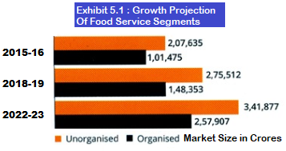
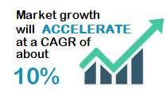
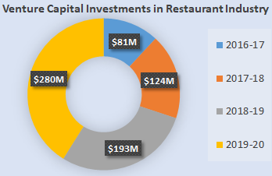
Market Research Convergence
Source: NRAI & FICCI / PwC, World Bank
Trend #1: Ethnic cuisine will increasingly be present in organized and hygienic set-ups
Trend #2: Food tech will continue to ‘organize’, driving increased focus on consumers, innovation & efficiency
Trend #3: Restaurants will increasingly focus on consumer engagement using technology
Trend #4: Health and wellness will continue to ride high on consumer preferences
Trend #5: Traditional packaging will make way for innovative food packaging

Slide 6
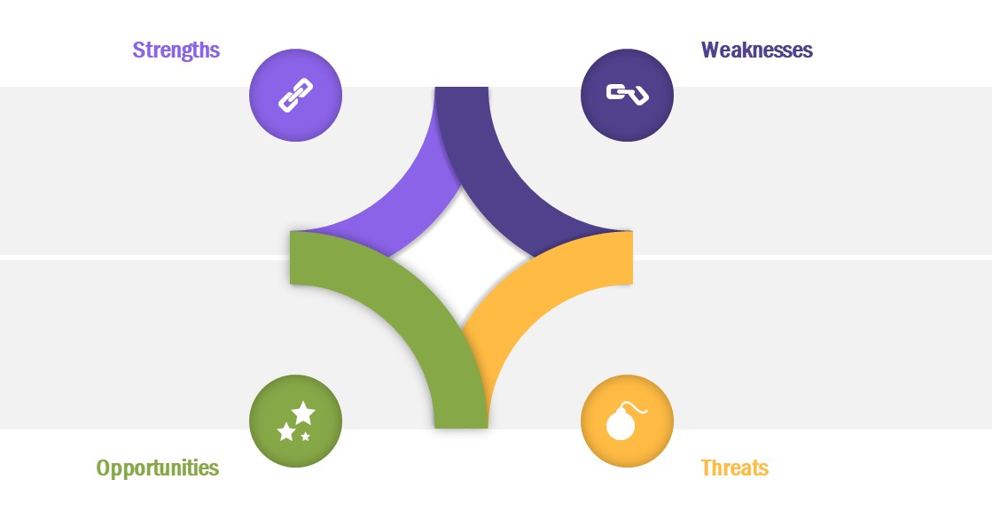
SWOT Appraisal
Distinct service offerings
Need for change
More value for money for customers
Changing mindset in vast market
Dedicated merchant solution
Brand Establishment
Absence of support from Venture Capital or Institutional Investors
Rising disposable income
First mover’s advantage
Technology innovations
Rising Urbanization
International tie-ups
Expansion of existing service aggregators into hospitality business
Competition from global players
If we wont do it, someone else will

Slide 7
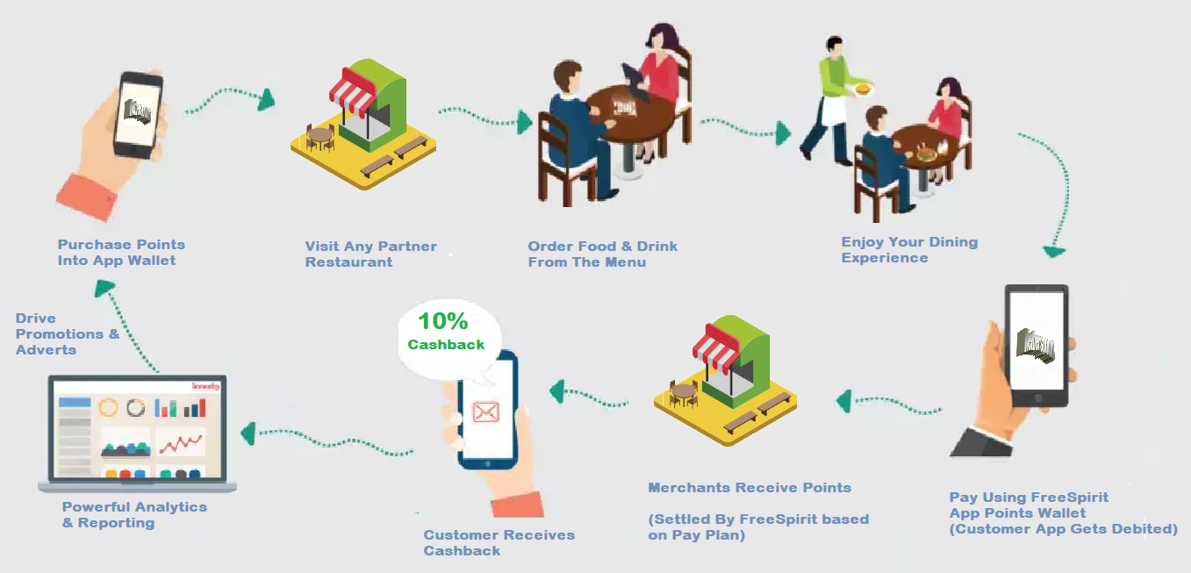
Indicative Process Flow – Purchase

Slide 8

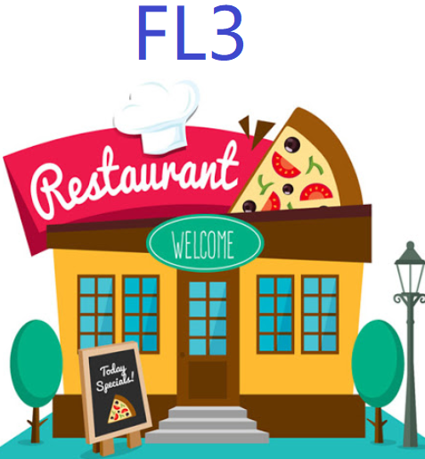
Value Proposition
Event Broadcast & live Streaming
Offer Event
Packages
Attractive Games
& Chat
Socialize
By Offering
A Drink
Economical
Delivery
Increased reach through acceptance & branding
Unique interactive platform for FL3
Reduced delivery costs
Increased
Footfall
Top standards for wellness & hygiene
Socializing opportunity for socially distant
More value for money through cashback offers
Gift / Share
A Drink
Anyone
Anywhere
Anytime
Off
Season
Boost
New
Customer
Base
Have Drink,
& get
Cashback
Multi City
Platform
Corporate Events & Flexible Packages
Range
Of FL3 to choose
Occasional
Promotion
Higher Customer
Retention
Register
For Local
Events
Cost Effective
Marketing
Cashback
& Exciting
Offers

Slide 9
Project Plan – 6 Waves
Wave 06
April 2023
Expand in existing 10 Cities & explore additional scope
Target 3600 FL3 & 3.6 Lacs FL4 Customers in Each City
3600 FL3
36Lacs FL4
3000 FL3
30 Lacs FL4
Wave 05
October 2023
Expand in existing 10 Cities & explore additional scope
Target 3000 FL3 & 3 Lacs FL4 Customers in Each City
Wave 04
April 2022
Expand in existing 10 Cities & explore additional scope
Target 2400 FL3 & 2.4 Lacs FL4 Customers in Each City
2400 FL3
24 Lacs FL4
1800 FL3
18 Lacs FL4
Wave 03
October 2022
Expand in existing 10 Cities & explore additional scope
Target 1800 FL3 & 1.8 Lacs FL4 Customers in Each City
Wave 02
April 2021
Expand in existing 10 Cities & explore additional scope
Target 1200 FL3 & 1.2 L acs FL4 Customers in Each City
1200 FL3
12Lacs FL4
Wave 01
October 2021
Launch in 10 Cities
Target 600 FL3 & 60 thousand FL4 Customers in Each City
Company Registration – July 2020 - Complete
App Development – November 2020
Foundation Period – Nov-20 to Mar-21
RBI Approval & Launch – April 2021 (Wave 0)

Slide 10
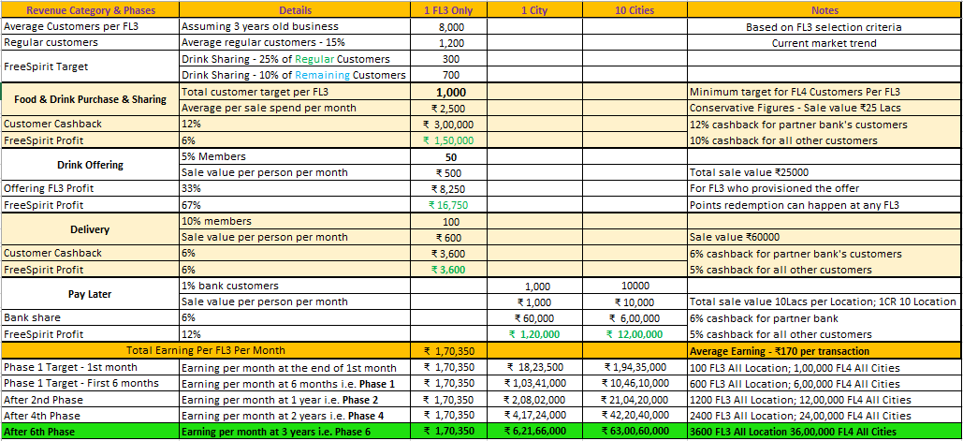
Revenue Model

Slide 11
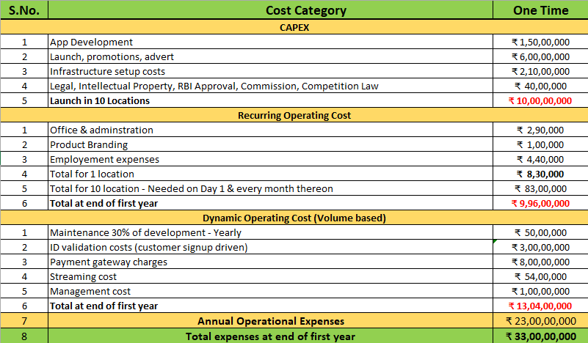
Capital Investment & Operational Expenditure

Slide 12
Future Vision
Horizontal expansion of broadcasting & micro-finance services
Multi-tier membership with range of features as remote connect, year-end party, hotel booking etc.
Patent, Sponsored Event Services, Corporate Tie-Ups
Pricing diversification, Pan-India launch, Integration with other popular apps
FreeSpirit Hangout for close friends & family and personalized theme based offers, events & alerting
Data science & analytics, Supply-chain services
Streaming services, Overseas launch, Integration with other apps
FL3 appraisal & customer rating, FLXC support
SOP standardization & master training

Slide 13






Question & Answers

